Slide 1


High Impact Skills Development Program AI & Data Science
Object Detection for Road Turn Detection in Gilgit using YOLOv8
Submitted By: Anzal Hussain
Roll # GIL-DSAI-208
Email : anzaljussainpoetry@gmil.com
GitHub Profile: https://github.com/Anzal-hussain-Anzal/Object_Detection_Project/upload/main
s

Slide 2
Table of content
1.
Learning Objectives
2.
Project Overview
3.
Data Preparation and Preprocessing
4.
Data Model Configuration
5.
Training and Validation Results
Model Evaluation and Prediction
6.
7.
Conclusion

Slide 3
Learning Objectives
Understanding Object Detection with YOLOv8
Data Preparation and Annotation for Object Detection
Model Training and Hyperparameters Tuning
Evaluating Object Detection Models
Implementing Object Detection in Real-World Scenarios
Code Documentation and Report Writing
Exploring Advanced Techniques for Model Improvement

Slide 4
Project Overview
This project aims to detect various road conditions (e.g., right turn, left turn, straight, unexpected) in road images using an object detection model trained with YOLOv8.
The goal is to develop a model that accurately identifies road features in challenging environments like Gilgit.

Slide 5
Model Training Configuration
Model: yolov8m.pt initially, later yolov8s.pt.
Epochs: First run with 20 epochs, then 10 more with adjusted parameters.
Batch Size: 16 initially, then adjusted to 5.
Image Size: 640x640, Learning Rate adjusted to 0.001 in later training.

Slide 6
Training and Validation Results
Initial Training : 20 Epochs, Batch 16
Precision: 74.1%, Recall: 15%, mAP50: 0.269, mAP50-95: 0.155.
Second Training: 10 Epochs, Batch 5, LR 0.001
Precision: 10.3%, Recall: 28.9%, mAP50: 0.147, mAP50-95: 0.029.

Slide 7
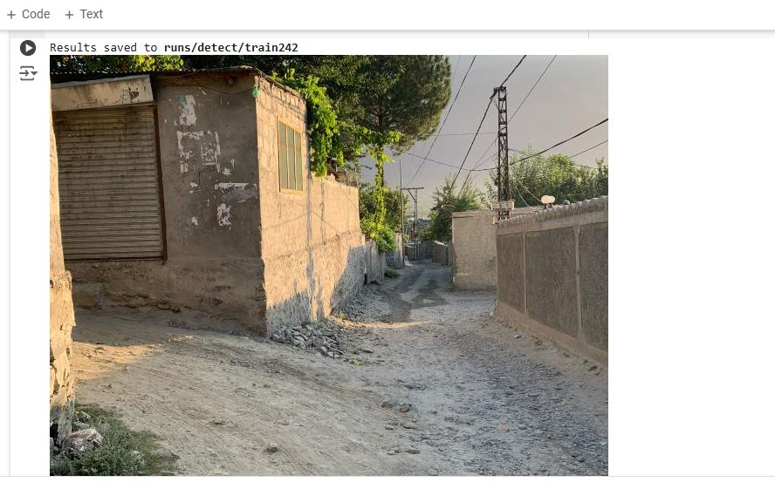
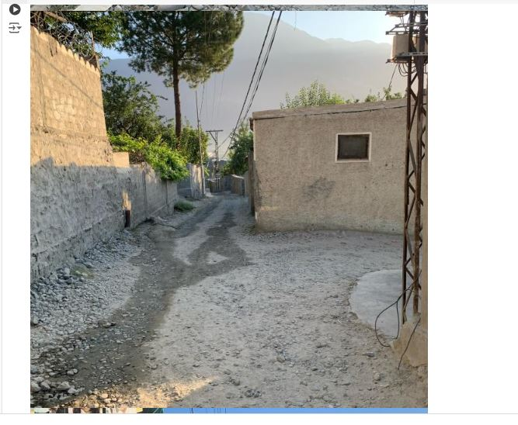
Model Evaluation and Prediction
Model evaluated on test images, predictions saved for visual analysis.
Further tuning and data augmentation needed for recall improvement.
Code for predictions:
results = model.predict('/path/to/test/data', save=True)

Slide 8
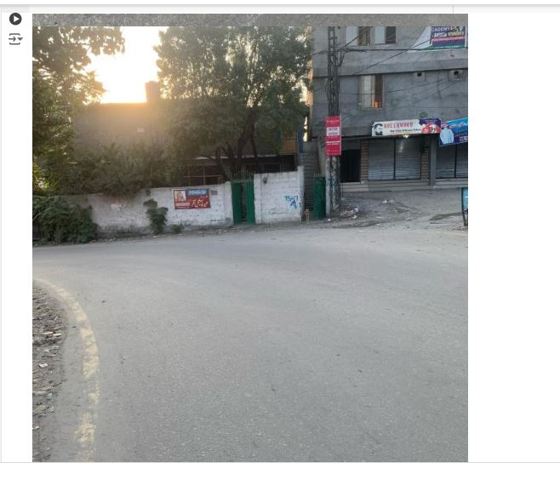
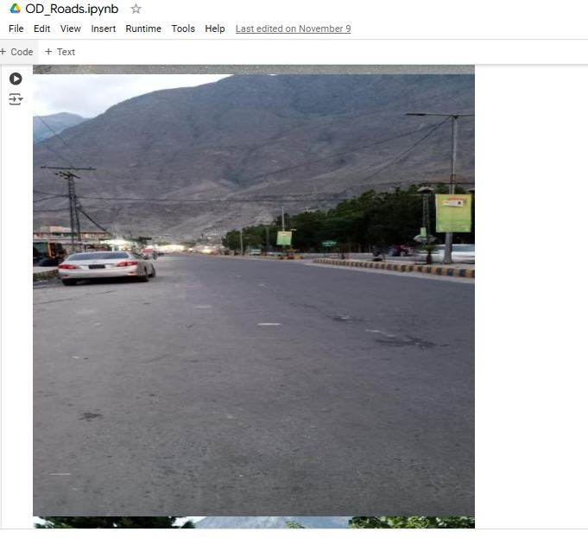
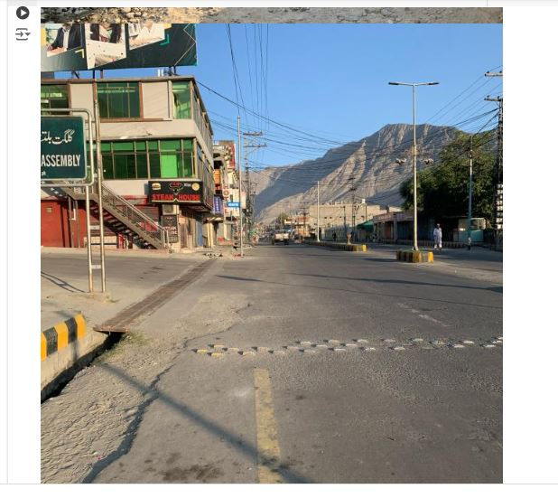
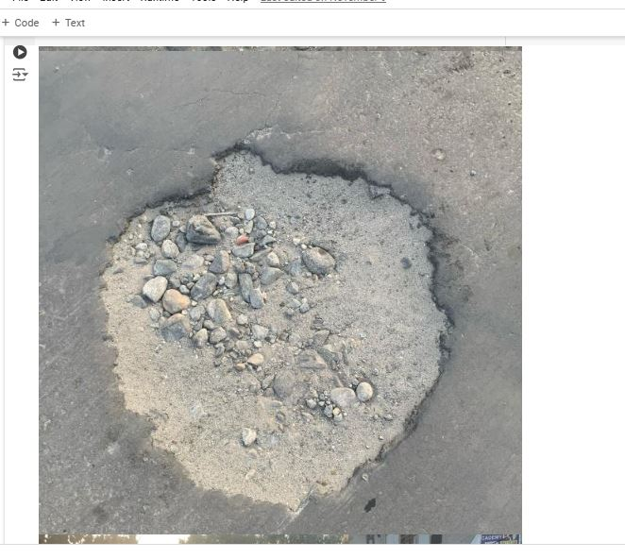

Slide 9
Conclusion
The YOLOv8 model demonstrated high precision but struggled with recall.
With additional tuning, augmentation, and model adjustments, the model’s detection accuracy can be improved.
This project has potential applications in real-time road detection for enhanced safety.

Slide 10
Referencing:
Git-Hub
GhatGPT
YouTube : https://www.youtube.com/

Slide 11
THE END

